Slide 1
Database Design and Development
Topic 11:
Data Warehouses
Notes:
NCC Education - Title Master

Slide 2
Scope and Coverage
This topic will cover:
  The need for business intelligence and the concept of the data warehouse
  The difference between Online Transaction Processing (OLTP) systems and data warehousing
  The architecture and main components of a data warehouse
Notes:
NCC Education - Slide Master

Slide 3
Learning Outcomes
By the end of this topic students will be able to:
  Understand the potential need for a data warehouse
  Differentiate between on-line transaction processing systems and data-warehouse system
  Identify the main components of a data warehouse

Slide 4
Why need a Data Warehouse? - 1
Two types of database processing
OLTP - On-line transaction processing.
It is a class of program that facilitates and manages transaction-oriented applications.
It is used for supporting daily busyness.
OLAP - On-line analytical processing
It is a way of viewing data in a multidimensional format.
It is used for supporting decision making.

Slide 5
Why need a Data Warehouse? - 2
The need for business intelligence
competitive environment
strategic planning
decision making
Proliferation of different systems

Slide 6
Databases Designed for OLTP are not Suitable for OLAP
  Content
  Accessibility
  Form
  Performance
  Availability
  Data Warehouse is a solution

Slide 7



Supermarket Systems
Webserver and database for
On line shopping
Internet and VPN or WAN
On-line shopping
LAN
Customer Records database
Stock taking and reordering database
Customer with loyalty card
Point of Sale
OLTP for point of sales

Slide 8
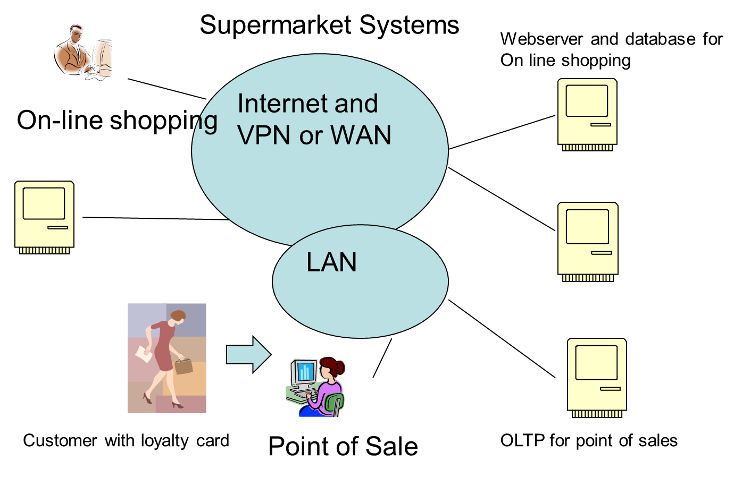
Activity – Identify the Types of Data been Collected and Used here?

Slide 9
And… What Benefits from Bringing this Data Together? - 1

Slide 10
And… What Benefits from Bringing this Data Together?
Sales Trends
Customer Buying habits
Regional variations
Variations by time
Goods generating
profit

Slide 11
Transform “Data” into “Information”
  Data Warehouse provides a multidimensional view of an organization’s operational (OLTP) data to help user make more informed, fast decisions.

Slide 12
What is a Data Warehouse?
  Subject-oriented
  Integrated
  Time-variant
  Non-volatile
Combining data in support
of management’s decisions
Data Warehouse

Slide 13
Subject Orientation
Data warehouse
Operational System
sales
customer
warehouse
supplier
Loyalty card
Online sales
product
buying
An application orientation
A subject orientation

Slide 14
Integration
OLTP System
Data warehouse
App1-m,f
App2-1,0
App3-male,female
Integration
m,f
App1-date(yymmdd)
App2-date(mmddyy)
App3-date(ddmmyy)
Integration
Date(ddmmyy)

Slide 15
Time Variant
OLTP System
Data warehouse
time horizon – 60-90 days depending on business
key will not usually have an element of time
data can be changed
time horizon – long term 5-10 years
key will contain an element of time
data cannot be changed

Slide 16
Non-Volatile
create
update
access
load
…
access
delete
retrieve
Operational System
Data warehouse

Slide 17
The Data Warehouse Functional Model
Acquisition
Storage
Access
Users
Query
OLAP
Statistics
Discovery
Mining
Others
Date
Extraction
&Prep
Data base
Or Other
Storage
Users

Slide 18
Acquisition
  Identifying the necessary data from legacy system (and other data sources).
  Validating that the data is accurate, appropriate, and usable.
  Extracting the data from the original source
  Preparing the data for inclusion into the new environment.
  Staging the information – making the data ready for loading into the warehouse itself

Slide 19
Storage
  Storage is the heart of a data warehouse
  An environment (the data warehouse) is constructed to provide a place from which the data from the source systems can be accessed

Slide 20
Access Tools
  Query and Reporting Tools
  OLAP Tools
  Statistical Analysis Tools
  Data Discovery / Data mining Tools
  Graphical and Geographic Information Systems

Slide 21
Seven Steps to Building a Data Warehouse
  Determine the needs of the end users
  Identify the necessary data sources
  Analyse the data sources in depth
  Use the information to work out how the data will need to be transformed
  Create the meta data which describes the transformation and integration that to occur
  Create the physical data warehouse and populate from various sources
  Create the end use applications

Slide 22
An Example of A Data Warehouse
Meta Data
Purchasing
System
Order Processing
System
Inventory
System
Transformation/Integration
Process
Data Warehouse
Production Planning
Distribution
Customer Service
Applications

Slide 23
Data Warehouse Schemas
  Star Schemas
  Snowflake schemas
  Starflake schemas

Slide 24
Star Schema
Central table surrounded by reference tables
Customer loyalty data
On-line sales
Fact Table e.g. Sales trends
Store sales

Slide 25
Snowflake Schema
Each dimension can have a number of its own dimensions
Item Type sales by customer
On-line sales
Customer loyalty
Fact Table e.g Sales Trends
Region information
Store sales by Item type
Store sales

Slide 26
Starflake Schema
Some de-normalisation
On-line sales
Customer loyalty
Fact Table e.g Sales Trends
Region information
Store sales by Item type
Store sales

Slide 27
OLAP – On-line Analytical Processing
  Consolidation
  Drilling-down
  Pivoting
  Multi-dimensional data

Slide 28
Midlands
Region
Month
South
North
A M J J A
2009
34
36
34
54
60
Year
2010
38
34
55
58
56
Multi-dimensional data – sales of Ice cream in thousands

Slide 29
Codd’s Rules for OLAP Tools - 1
  Multi-dimensional conceptual view
  Transparency
  Accessibility
  Consistent reporting performance
  Client-server architecture
  Generic dimensionality
  Dynamic sparse matrix handling

Slide 30
Codd’s Rules for OLAP Tools - 2
  Multi-user support
  Unrestricted cross-dimensional operations
  Intuitive data manipulation
  Flexible reporting
  Unlimited dimensions

Slide 31
Learning Outcomes
By the end of this unit students will be able to:
  Understand the potential need for a data warehouse
  Differentiate between on-line transaction processing systems and data-warehouse system
  Identify the main components of a data warehouse
Did we meet them?

Slide 32
References
  Benyon-Davies, Paul. Database Systems Palgrave Third Edition 2004 Chapters 40 and 41
  Connolly, Thomas M., and Begg, Carolyn E., Database Systems: A Practical Approach to Design and Implementation Addision-Wesley, Fourth Edition 2005 Chapter 31, 32 and 33
  Inmon, W.H., “Building the data warehouse” http://inmoncif.com/inmoncif-old/www/library/whiteprs/ttbuild.pdf retrieved 15th August 2011

Slide 33
Topic 11 – Data Warehouses
Any Questions?
Notes:
NCC Education - End Slide Master

